Slide 1
Knowledge Representation

Slide 2
About Knowledge Representation
Search-based problem solving programs require some knowledge to be implemented.
  Knowledge can be a particular states or path toward solution, rules, etc.
Before being used knowledge must be represented in a particular way with a certain format.
In this session we are looking at the specific way and technique that can be used for representing and manipulating knowledge within programs.

Slide 3
Representation and Mapping
AI can be used to solve a complex problems.
Large amount of knowledge as well as some means of manipulating that knowledge is required to create solutions for the complex problems.
In the representation there are two different entities that must be considered:
  Facts: truths in some relevant world. These are things that we want to represent
  Representation of facts in some chosen formalism. These are things that can actually be manipulated.

Slide 4
Representation and Mapping
Structuring of these entities can be done in two levels:
  The knowledge level at which facts are described
  The symbol level at which representation of some objects at the knowledge-level are defined in terms of symbols that can be manipulated by programs.

Slide 5
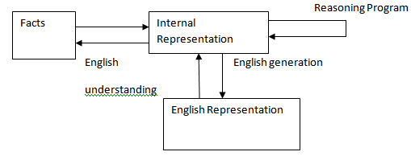
Representation and Mapping
Mappings between Facts and Representation

Slide 6
Representation and Mapping
Our main goal is to focus on:
  Facts
  Representation
Two-way mappings
The links - called representation mappings.

Slide 7
Representation and Mapping
Representation mappings are:
  Forward representation which maps from facts to representation.
  Backward representation which maps the other way.
One representation of facts concerns with natural language (particularly English) sentences.

Slide 8
Representation and Mapping
English representation fact in order to facilitate information into and out of the system.
Mapping functions from English sentences to the representation we are actually going to use and from it back to sentences
For example we can use mathematical logic as the representation formalism. Consider the English sentences below
  Spot is a dog
This fact can also be represented in logic as follows:-
  Dog(Spot)

Slide 9
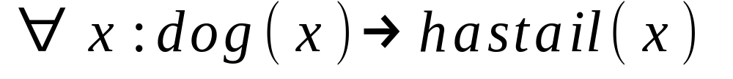
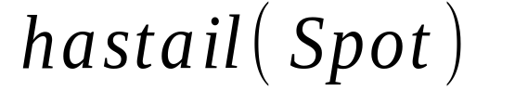
Representation and Mapping
Suppose we have a logical representation of the fact: all dogs have tails as shown below:
∀x: dog(x) → hastail (x)
Using the deductive mechanisms of the logic, we may generate the new representation object.
Using an appropriate backward mapping function we could then generate the English sentence:
  Spot has a tail
we could use this representation of new fact to cause us to take some appropriate action or to derive representation of additional facts.

Slide 10
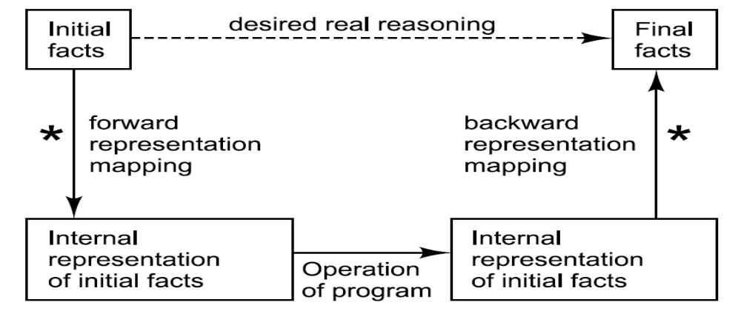
Representation and Mapping
Representation of Facts
The doted line on top indicates the abstract reasoning process that a program is intended to model.
The solid lines on bottom indicates the concrete reasoning process that the program performs.
80

Slide 11
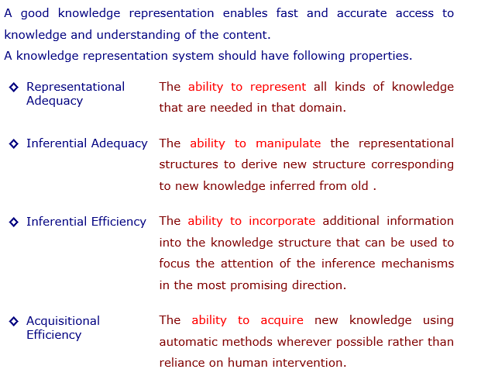
Properties of a Representation System

Slide 12
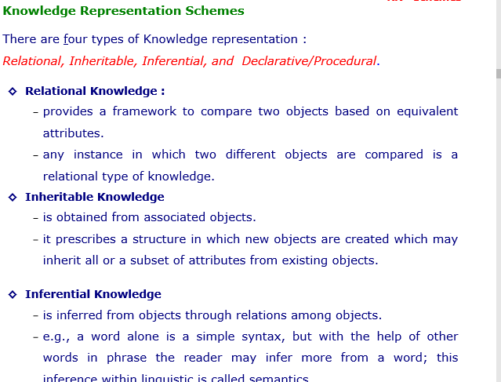

Slide 13
Approach to Knowledge Representation
There are multiple techniques for knowledge representation.
Different representation formalisms
  Rules
  Logic
  Natural language
  Database systems
  Semantic nets
  Frames
  Conceptual dependency
  Scripts
Many programs rely on more than one technique.

Slide 14
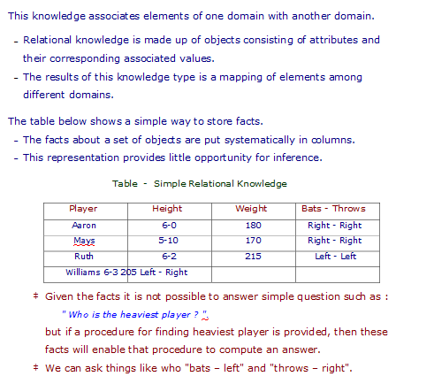
Relational Knowledge

Slide 15
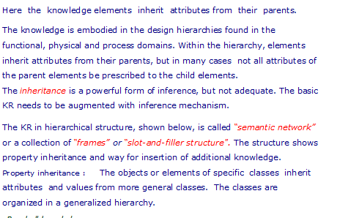
Inheritable Knowledge

Slide 16
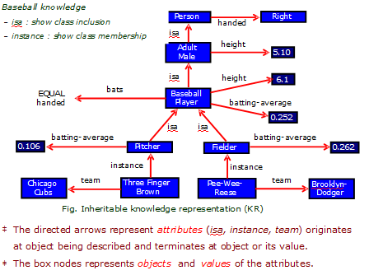
Inheritable Knowledge

Slide 17
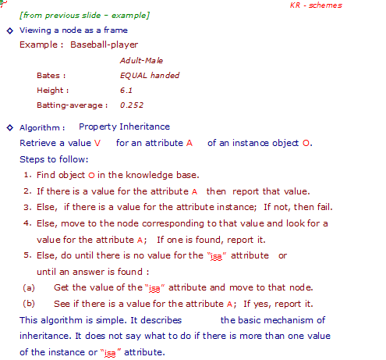
Inheritable Knowledge

Slide 18
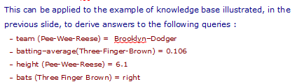
Inheritable Knowledge

Slide 19
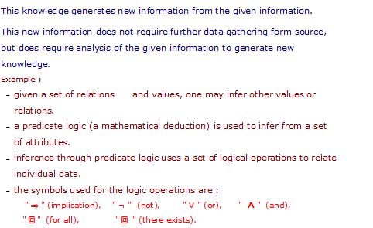
Inferential Knowledge

Slide 20
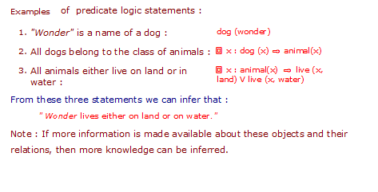
Inferential Knowledge

Slide 21
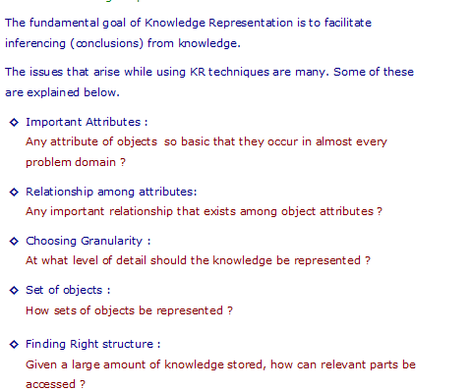
Issues in Knowledge Representation

